Slide 1

Hyperparameter tuning
Using an appropriate scale to pick hyperparameters
deeplearning.ai

Slide 2
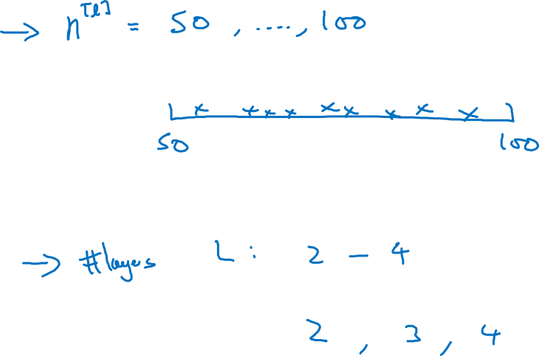
Picking hyperparameters at random

Slide 3
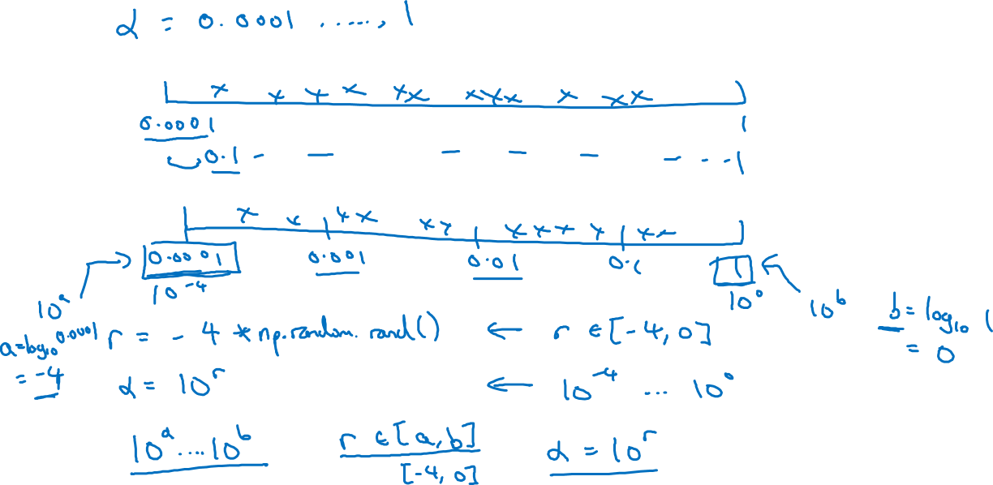
Appropriate scale for hyperparameters

Slide 4
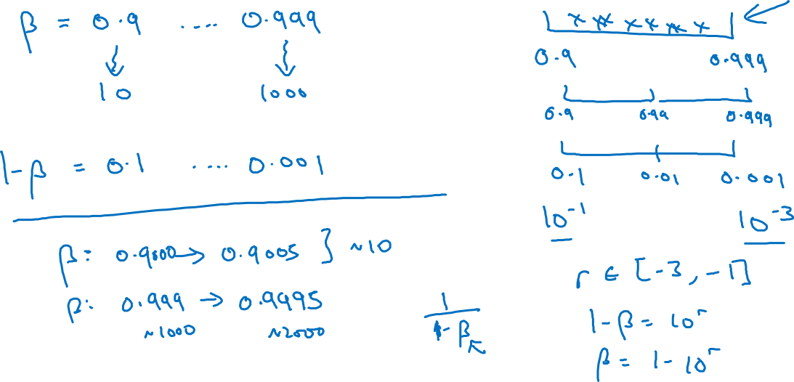
Hyperparameters for exponentially weighted averages

